Slide 1
Determining best location for A fast food establishment
Vishaal Rao
16 April 2019

Slide 2
Where can the following project be used?
If a business man wishes to open an establishments of any kind such as a restaurant, car dealer ship could use a methodology similar to the one used here.
We can use it for hospitality different services such as lodges, hotel services, transportation services based on footfall, location.
Any algorithm which suggests the best fast food restaurants to its users.

Slide 3
Data acquisition and cleansing
The data for restaurant location, rating, number of likes, price range and the data for railway locations were obtained through foursquare API.
The data for footfall in railway stations were data scraped from a blog post.
When some ratings and price range were found to be N/A, they were replaced with the mean of the rest of the observations.
One of the stations, Goregaon station, had multiple entries of fast food restaurants near it but wasn’t present in the Foursquare database. Thus, was manually added to the table.
Station which were far from any of the restaurants were removed from the table.

Slide 4
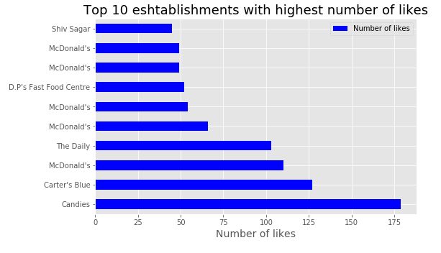
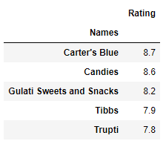
Individual restaurants performed better than chain of a certain restaurant
It was noticed that individual restaurants performed better in terms of rating and likes than chain restaurant such as McDonalds.

Slide 5
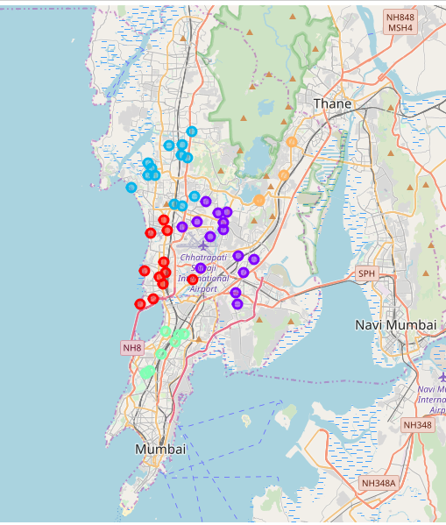
Clustering
By observing the fast food restaurant map it was noticed that the restaurant locations could be clustered into 5 parts.
Hence a value of 5 was considered for the K means clustering.

Slide 6
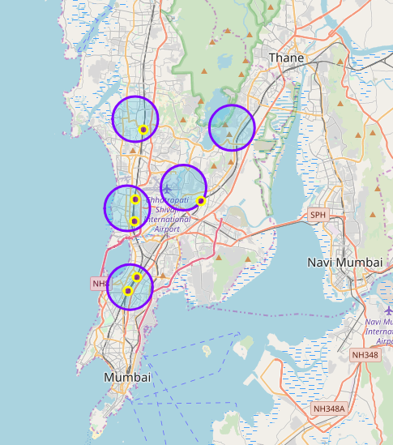
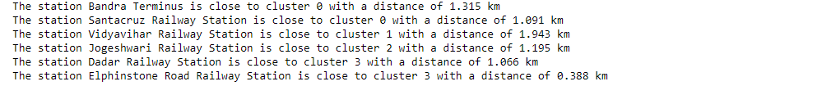
Selecting suitable stations
The stations within 2 kms of the cluster centres are taken into consideration
Upon mapping the results are as follows:

Slide 7
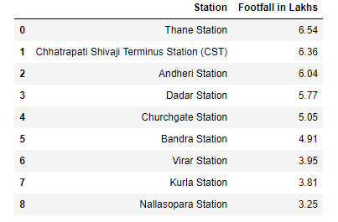
Finding optimal station based on footfall
Comparing the railway stations and the footfall accounts it is noticed that Bandra and Dadar stations would be the ideal places to open a fast food restaurant.
Bandra: 4.91 Lakhs
Dadar: 5.77 Lakhs

Slide 8
Conclusion and future directions
The individual restaurants generally have a higher rating and number of likes in comparison to the chain, while having a cheap price range.
Dadar and Bandra were found to be the best locations in comparison to the other stations.
More deciding factors such as places of tourism, schools, colleges etc will be added.
Based on the multiple factors a regression model will be built that could predict the ratings or the average footfall in a restaurant.

